Slide 1




Chronic Kidney Disease Prediction
Using Machine Learning Algorithms
Bianca-Gabriela Leoveanu
Costa Massena
Rolfis Ramses Solano Mendez
Machine Learning in Data Processing and Analytics

Slide 2
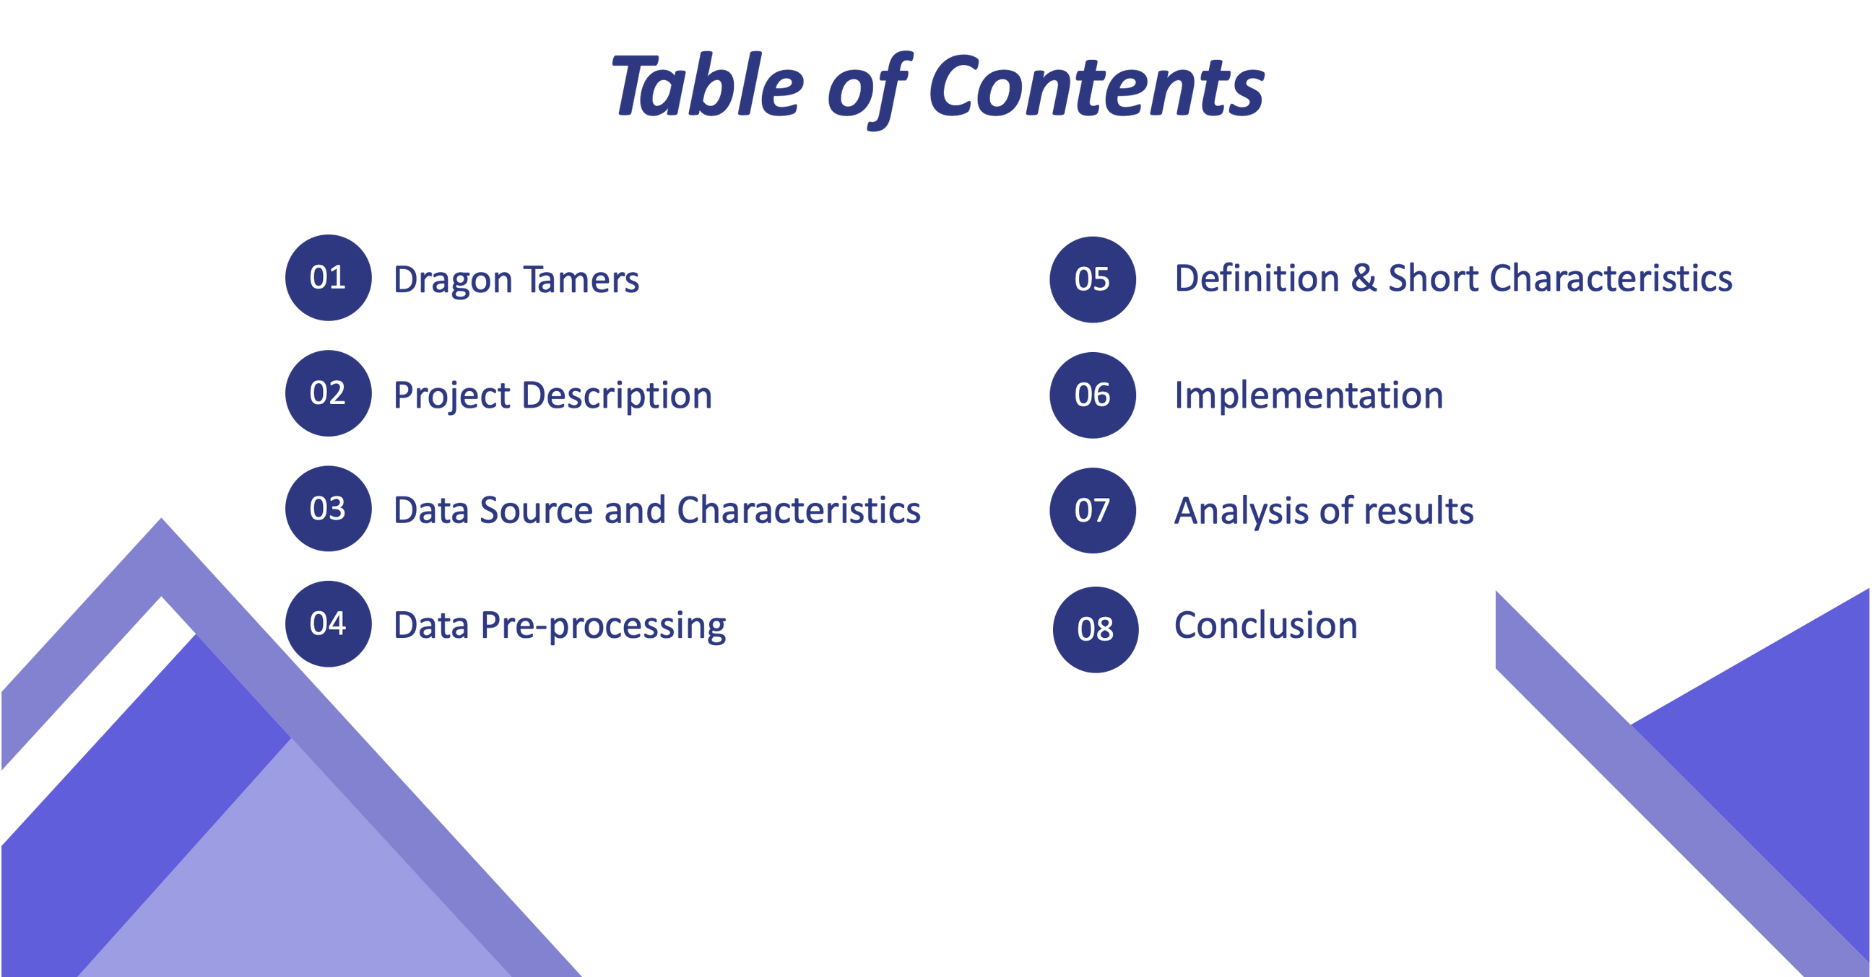

Slide 3



Dragon Tamers
Team Members
Bianca-Gabriela Leoveanu
Country: Romania 🇷🇴
Costa Massena
Country: France 🇫🇷
Rolfis Ramses Solano Mendez
Country: Germany 🇩🇪

Slide 4
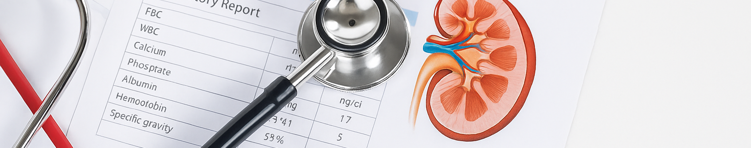
Project Description
🎯 Objective:
Predict chronic kidney disease (CKD) using machine learning.
🔍 Goal:
Discover patterns in patient data and support early CKD diagnosis using data-driven insights.
📊 Dataset:
Clinical records of patients with CKD indicators.
🧠 Algorithms Used:
🧪 Naive Bayes
🌳 Decision Tree
📍 K-Means Clustering

Slide 5

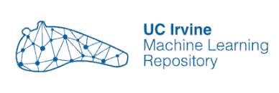
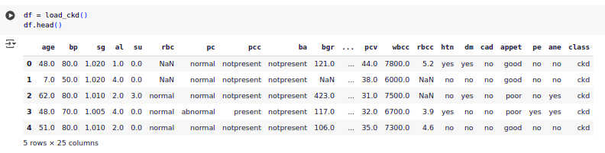

Data Source and Characteristics
Nominal values
Source of the data:
This data comes from the UC Irvine Machine Learning Repository
Our DataSet
Unit values
Missing values
Binary values (as char)

Slide 6
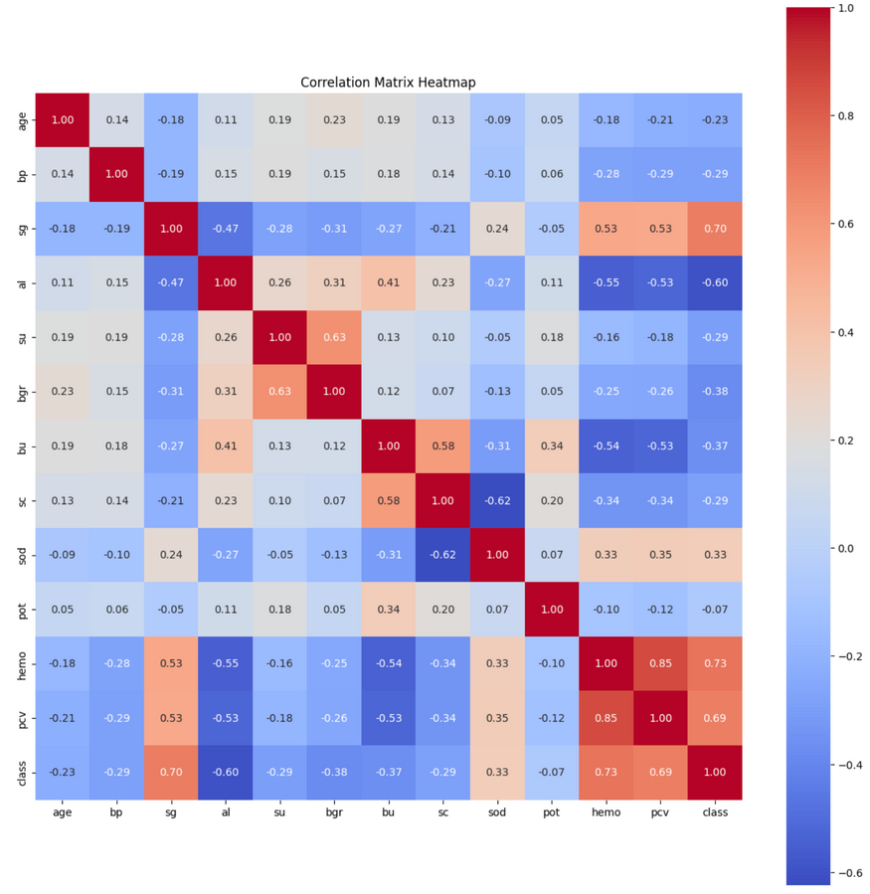
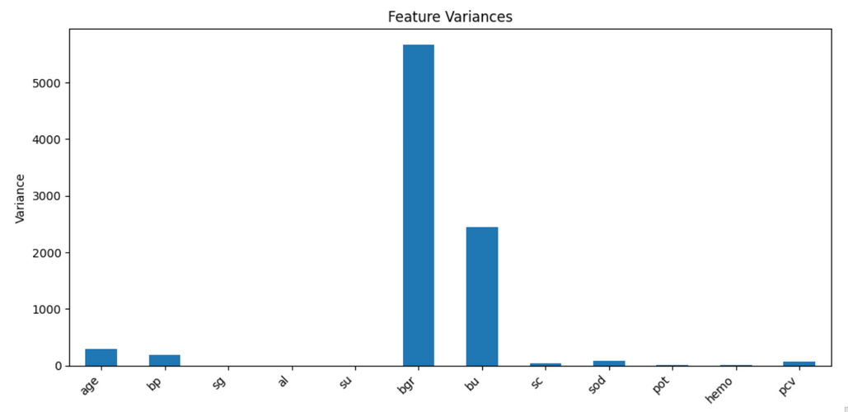

Data Pre-processing
📋 Steps in the Pipeline:
Cleaned & formatted data
Handled missing values and removed columns with > 25% missing
Encoded categorical features
Scaled numerical features (mean=0, std=1)
Analyzed correlation to remove redundant variables
Filtered low variance features (variance < 0.01)
📦 Output Datasets:
X_selected → for tree-based models
X_scaled_selected → for scale-sensitive models

Slide 7
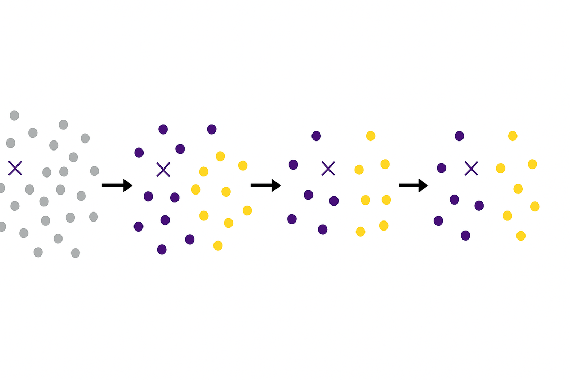
K-Means Clustering
📌 Type: Unsupervised learning algorithm
🎯 Goal: Group data into k clusters based on similarity
🔁 How it works:
Assigns points to nearest centroid, then updates centroids iteratively
⚡ Advantages:
Fast and simple, best for well-separated, round clusters
⚠️ Limitations:
Sensitive to initial placement and outliers
Clustering process with centroid updates

Slide 8
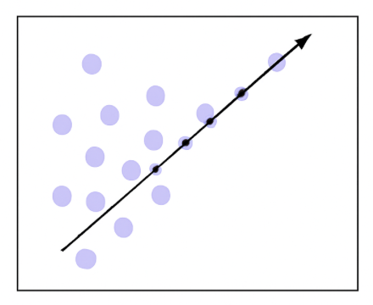
Principal Component Analysis (PCA)
📌 Type: Dimensionality reduction technique
🎯 Goal: Reduce features while preserving variance
🔁 How it works:
Projects data onto new axes of maximum variance
⚡ Advantages:
Simplifies data, removes redundancy
⚠️ Limitations:
Principal components may lack interpretability
Projection onto principal component (max variance direction)

Slide 9

Decision Tree
📌 Type: Supervised learning algorithm for classification (e.g. Email Spam Detection) and regression (e.g. House Price Prediction)
🎯 Goal: Predict class values by learning decision rules
🔁 How it works:
Calculate initial impurity
Divide features and split into left and right subsets
Find best split, max of information gain = Initial Impurity - Weighted Average Impurity
Create a node, then repeat until conditions are met
Assign class labels or regression values
⚡ Advantages:
Interpretability, Data Type Handling
⚠️ Limitations:
Overfitting, Instability
Decision tree structure showing splits and leaf predictions

Slide 10
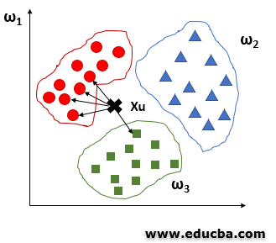
K-Nearest Neighbors
📌 Type : Instance-based, non-parametric algorithm
🎯 Goal : Classify data points based on the majority class of their nearest neighbours
🔁 How it works :
Find the k closest points and assign the most common class among them
📐 Common distance: Euclidean
⚡ Advantages:
No training needed, easy to implement
⚠️ Limitations:
Slower with large data, sensitive to irrelevant features

Slide 11
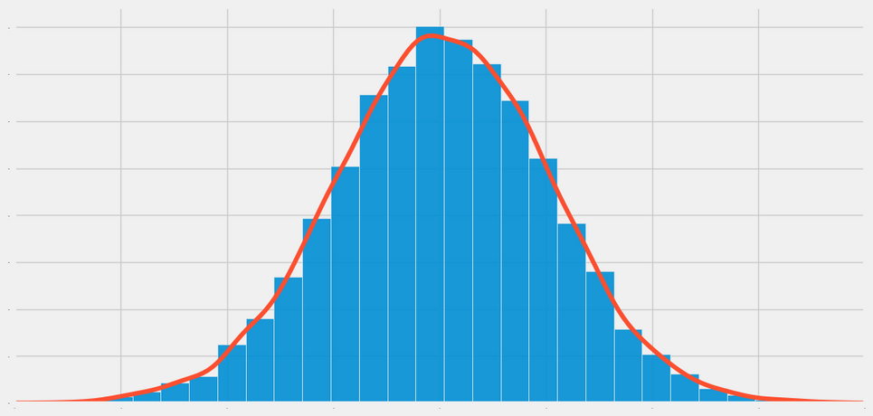
Naive Bayes
📌 Type : Probabilistic, based on Bayes’ Theorem
🎯 Goal : Predict the most likely class given input features
🔁 Steps :
Compute priors and likelihood → Apply Bayes’ rule → Choose class with highest score
🧪 Variants :
Gaussian - for continuous data
Multinomial - for count data
Bernoulli - for binary data
⚡ Advantages :
Fast, simple, and effective for small, categorical data
⚠️ Limitations :
Assumes feature independence, sensitive to noise and imbalance
Desired Gaussian Distribution Gaussian Naive Bayes

Slide 12

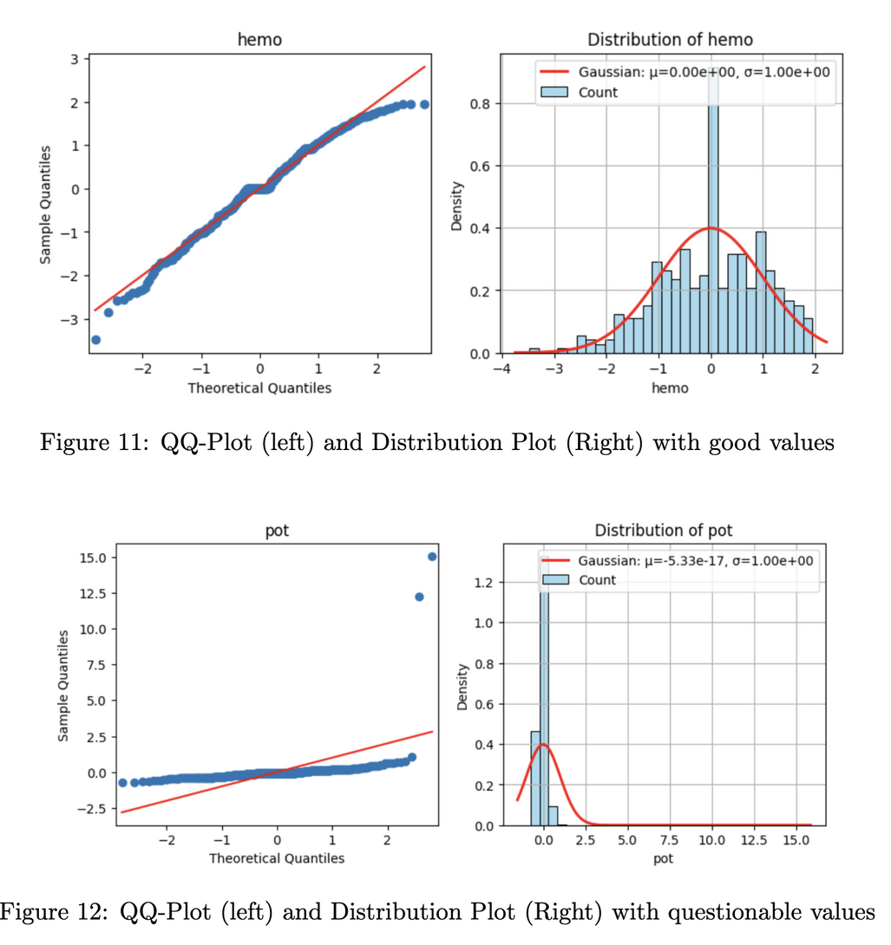
Naive Bayes - Implementation
📌 Assumes: Features follow a normal distribution
✅ Works well with standardized medical data
📊 Checked Normality:
QQ-Plot and Shapiro-Wilk test (hemo = 0.98, pot = 0.18)
🧪 Model:
80/20 split
Used priors to adjust imbalance
Applied cross-validation (2-9 folds)
Most appropiate test size of 12.5%

Slide 13
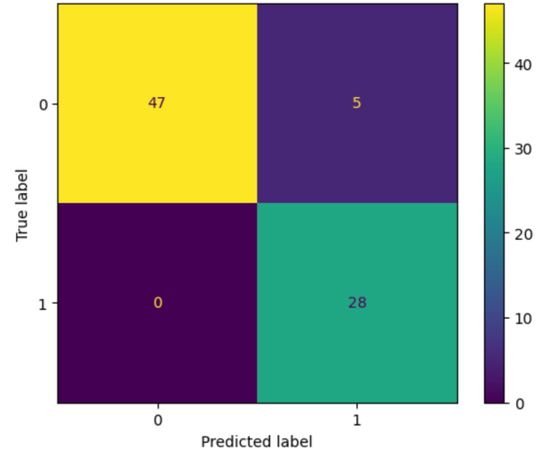
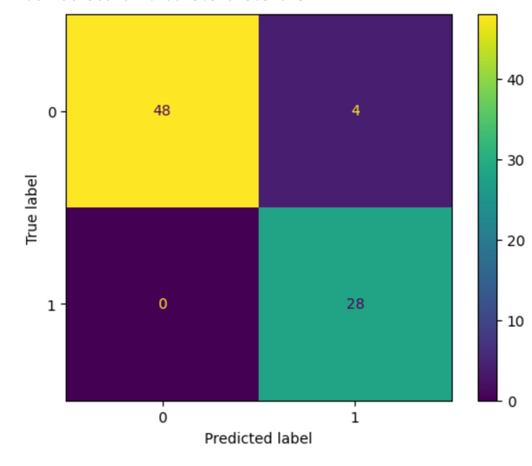
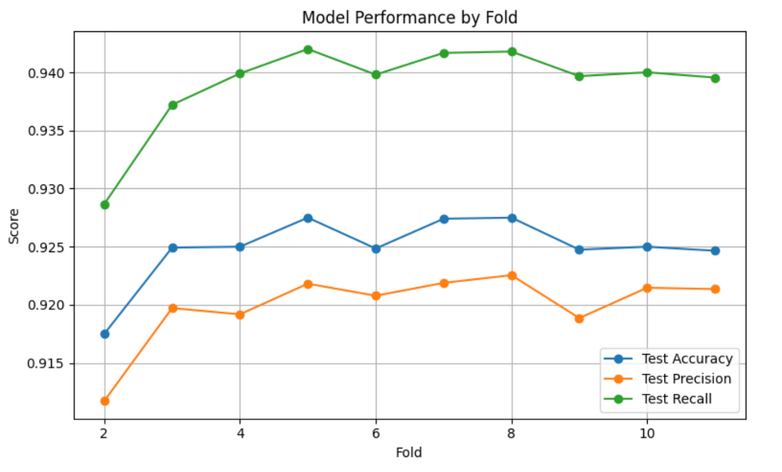
Naive Bayes - Analysis of Results
📊 Baseline Results (80/20 split):
Accuracy - 93.75%
Precision - 84.8%
Recall - 100%
F1 Score - 91.8%
AUC - 0.99
✅ High recall = all CKD cases correctly detected
⚠️ Lower precision = some false positives
🔧 With Priors (0.86 / 0.14):
Precision up by 3%, false positives down by 1
📈 Cross-Validation (2-11 folds):
Best performance at 8 folds (12.5% test split)
Higher precision, slightly lower recall

Slide 14
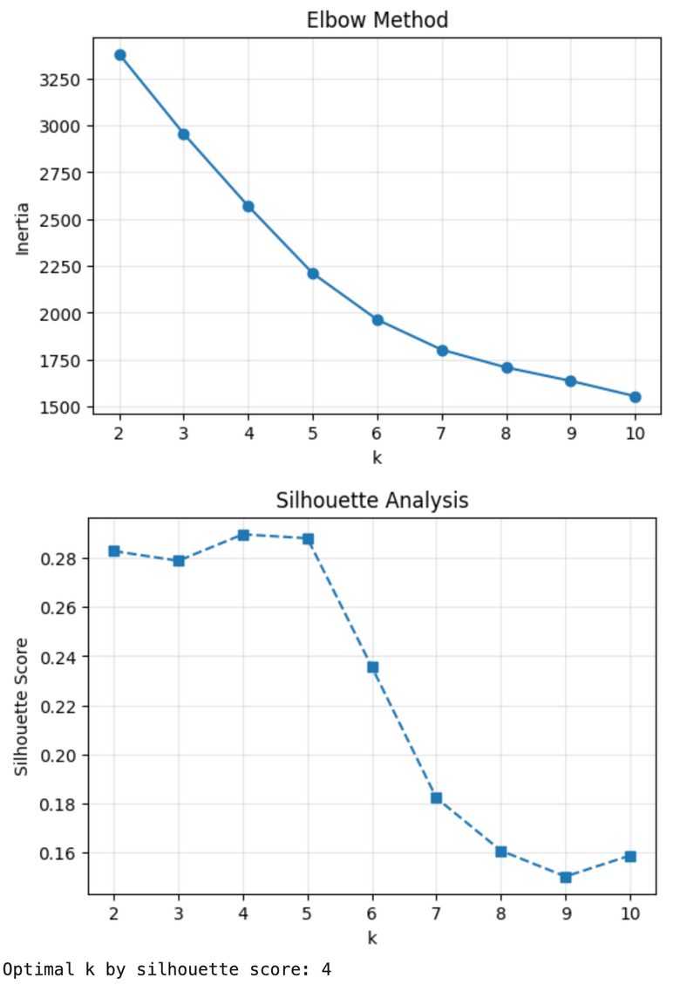
K-Means Clustering - Implementation
🔍 Overview:
Applied on scaled, feature-selected data
Unsupervised approach - no label used during training
📈 Finding the optimal k:
Tested k=2 until k=10
Evaluated using Inertia and Silhouette Score
🔬 Visual Evaluation:
Figure 1: Elbow method - inertia decreases with higher k
Figure 2: Sihouette scores peak at k=4
✅ Final Model:
Trained final K-Means with k=4
Added cluster labels to dataset for further analysis

Slide 15

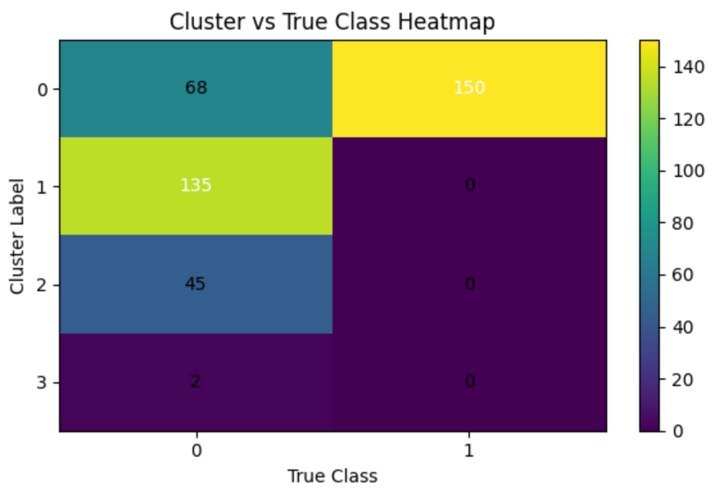
K-Means Clustering - Analysis of Results
📊 Evaluation Metrics for k=4:
ARI: 0.280 → Low class alignment
Purity: 0.830 → High cluster purity
📌 Cluster Composition:
Cluster 0: 150 CKD out of 218
Clusters 1, 2, 3: Entirely non-CKD
🔍 Interpretation:
K-Means captured CKD vd. healthy split
Other clusters show healthy subgroups

Slide 16
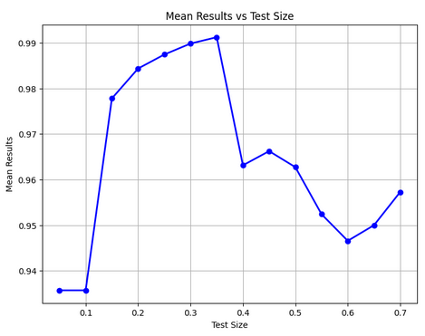
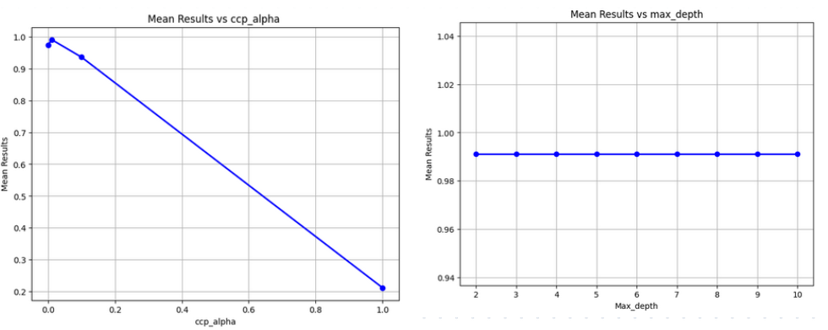
Decision Tree - Implementation
📊 Optimal Test Size:
Creation of a list of different test sizes
Creation of the DT for each size
Choosing the best by comparing evaluators
✅ Best test size selected: 0.35
⚙️ Optimal Function Parameters:
Creation of a list of different ccp_alpha
Creation of the DT for each one
Choosing the best by comparing evaluators
Do the same for the max_depth
✅ Best ccp_alpha selected: 0.01
✅ Chosen max_depth: 2 → higher values didn’t improve performance

Slide 17
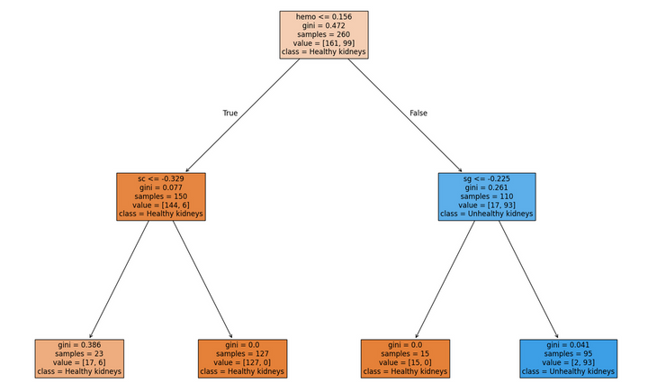
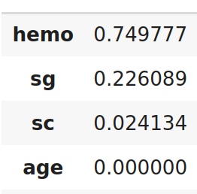
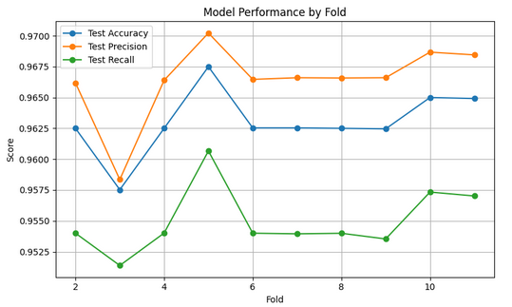
Decision Tree - Implementation
🧹 Feature Dropping:
Display the importance of each feature
Remove the ones that have no importance in creating the decision tree
Stock the 3 features remaining in a new dataset
🏗️ Creation of the final DT:
Train test split the data with the best split size
Making our decision tree with the best parameters
Displaying the decision tree and confusion matrix
Cross-validation

Slide 18
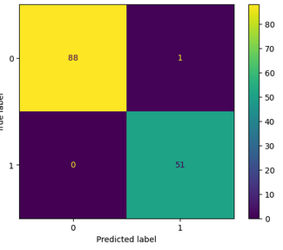
Decision Tree - Analysis of Results
✅ Accuracy score: 99.2%
Performance is excellent and acceptable for our classification
🎯 Precision score: 98.1%
Acceptable for our classification since most predicted positives were correct.
🔁 Recall score: 100%
All actual positives were correctly identified.
🧩 Analysis of the Confusion Matrix

Slide 19
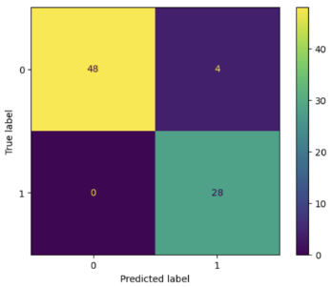
Conclusion
K-Means Clustering:
🔍 Comparing the methods
🏆 Choosing the best one
💡 What we have learned
ARI: 0.280
Purity: 0.830
Cluster 0: 150 CKD out of 218
Clusters 1, 2, 3: Entirely non-CKD
Decision Tree:
Naive Bayes:
Accuracy score: 99.2%
Precision score: 98.1%
Recall score: 100%
Accuracy score: 93.75%
Precision score: 84.8%
Recall score: 100%

Slide 20

Thank You!

